Slide 1
Final Project Presentation on Data Science Inventory
Group 6: Swathi Reddy
Akhil Tammina
Venkata Santhosh Danduru
Venkatvarun Madarapu

Slide 2
Data Science Inventory

Slide 3
Objective
Data Science Inventory is a system which provides resources or books list related to different fields of Data Science like Data mining, Data Analytics etc.
A SQL Database has been designed to store all the information of the books.
A website has been designed using HTML, CSS, Bootstrap, JavaScript and PHP for End User Interface to the Database.

Slide 4
User Requirements
There are two types of users who can access the website:
End User: who access to database with ‘read’ permission only through web application. They require minimum knowledge of accessing to the internet and search for their requirements.
Authorized User: A user can search for the existing records, can insert new records and can manage and maintain the webpage. User has to learn how to manage website and insert records.
Third type of User:
Database Admin User: Technical User who can control both Database and website management where he can access to backend code of the webpages.

Slide 5
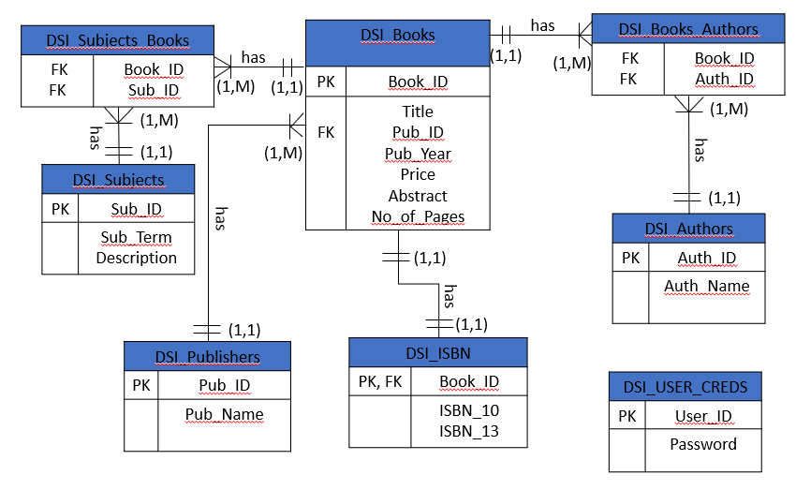
Database ERD

Slide 6
Database Entities
DSI_Books: This entity stores the basic information of book like title, price, number of pages and abstract.
DSI_Authors: This entity is to store information of Authors.
DSI_Subjects: This entity provides information of different subjects or fields related to DataScience
DSI_Publishers: This entity stores information of book’s publisher
DSI_ISBN: Both ISBN 10 and ISBN 13 are stored in this table.

Slide 7
URLs of the System
Home Page: http://iia02.ci.unt.edu/5717/group6/Home.php
Login Page: http://iia02.ci.unt.edu/5717/group6/Login.php
Search Page: http://iia02.ci.unt.edu/5717/group6/AtoZ.php

Slide 8
Features of DSI System
Design: Web pages are designed simple with optimization and fast webpage redirection.
Security: No direct access to admin page, rerouted to login page if directly access to specific web pages.
Data security: There is no option of editing data online, only entry option for authorized user. Only database admin can edit or control database.

Slide 9
Search Page
Main Page
Contact Us
Login
Log Out
DashBoard
Entry Form
Search Page
Tabular View
SITE MAP

Slide 10
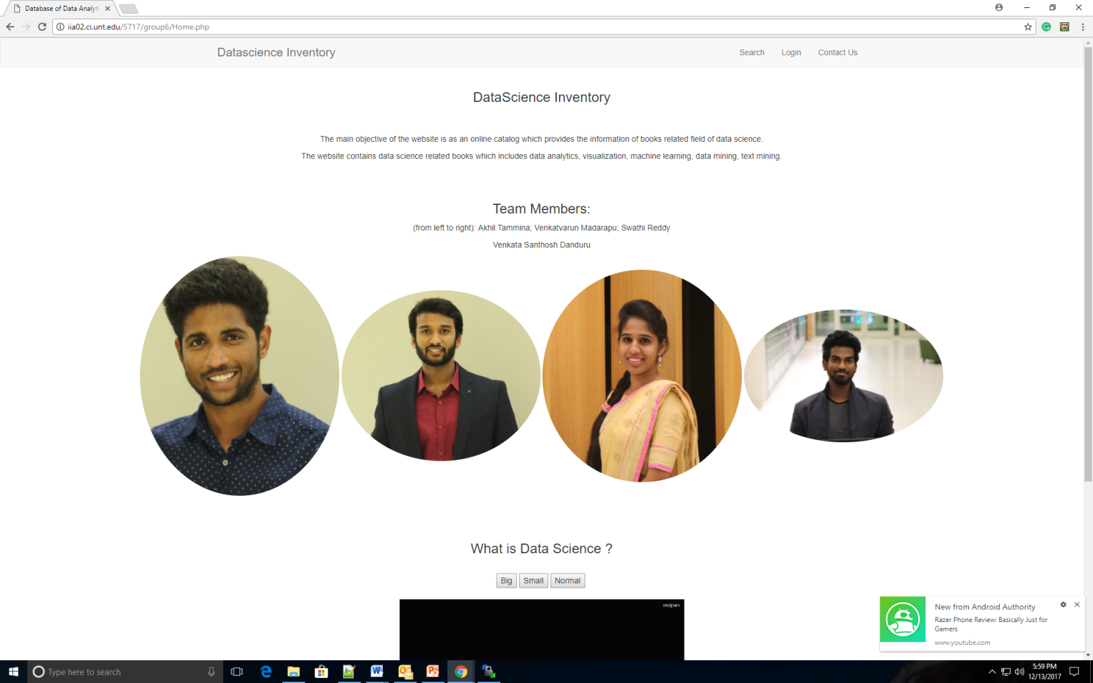
Home Page

Slide 11
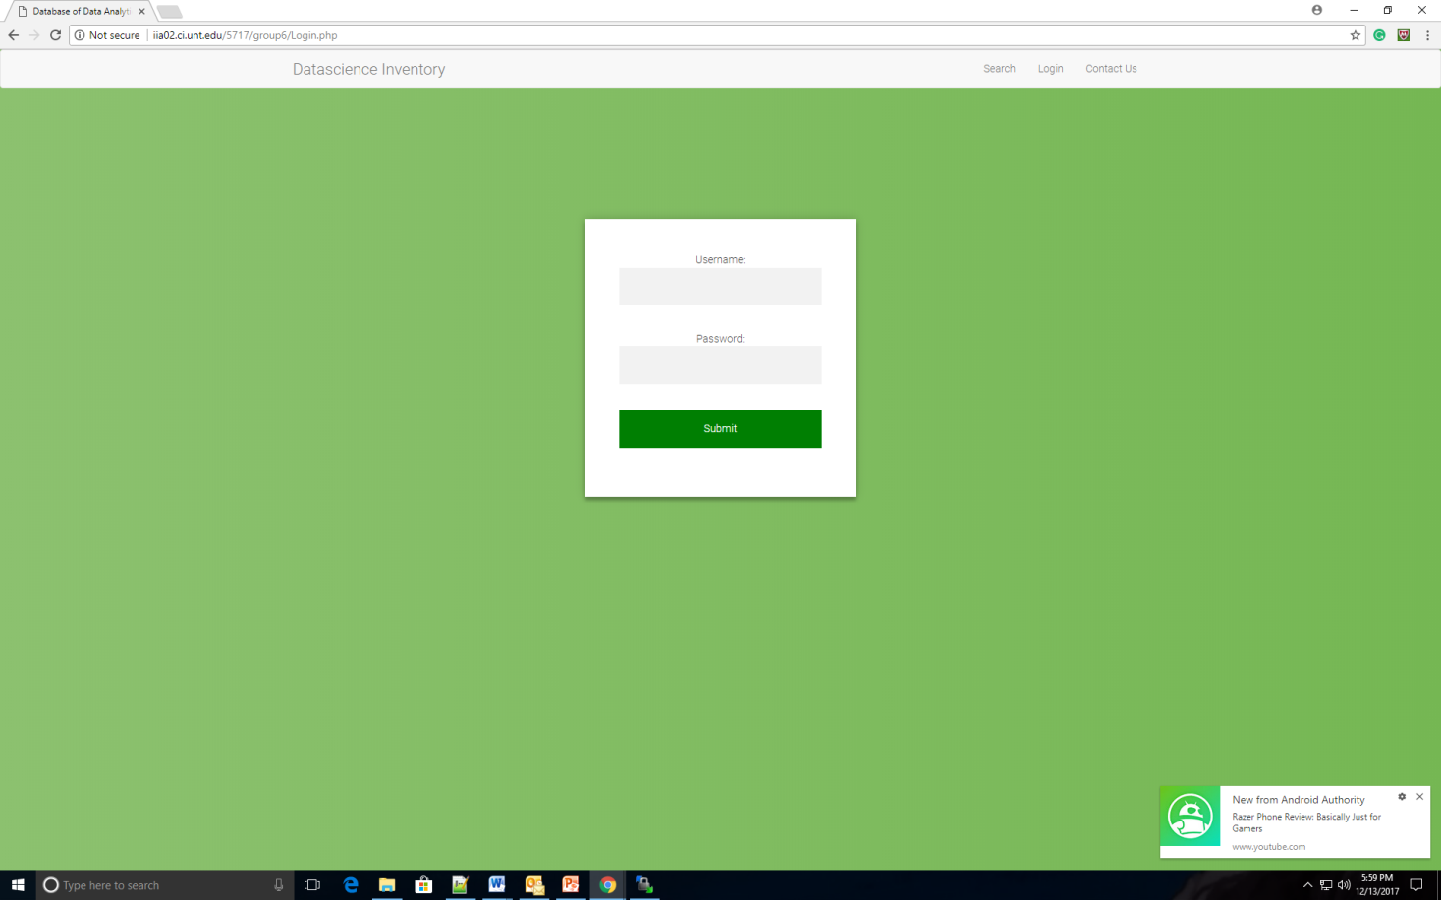
Login Page

Slide 12
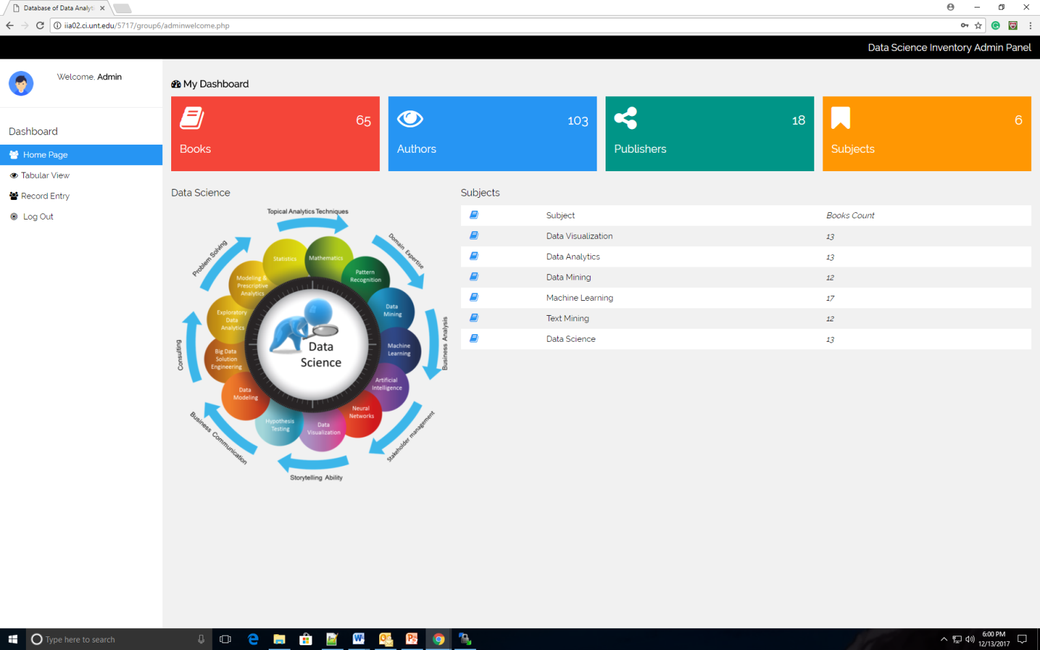
Admin Panel

Slide 13
User Credentials for Admin Panel
Username: admin
Password: admin

Slide 14
Thank you

